Slide 2

Notes:
You all probably know the situation when you‘re searching your phone. One option is to search it with your eyes or you go to iPhone-Search, like I did for you here.
Two problems visible here:
1. GPS 2D Position isn‘t that accurate
2. There is no indication of a height
These two problems = Motivation for my project (next Slide)

Slide 3
3D Positioning
Developing an accurate Embedded-System for estimating the position in 3d space
Notes:
3D Positioning; I‘m going to develop an embedded-system for estimating the position in 3D space with the goal to get good results in most of the situation.
main focus different weather conditions and infrastructures, but at the end also indoor navigation
And the idea or the principle is basically (next Slide)

Slide 4
Sensor fusion
“[…] the use of sensory data from multiple sources, combined into one comprehensive result.”¹ This means: “Using multiple sensors, planners can generate more robust data models or obtain greater numbers of data points for the purposes of a given system.”¹
Techopedia: Sensor Fusion http://bit.ly/SeNsOrFuSiOn (fetched on the 19.05.19)
Notes:
Sensor Fusion, which is according to Techopedia „(read from slide)„ This means „(read Slide)“
In other words, sensor-fused based systems combine the advantages of all the used sensors with the idea of making it better than each sensor alone.
The methods for achieving this goal belong all to the estimation theory, which is in other words the theory signal filtering.

Slide 5
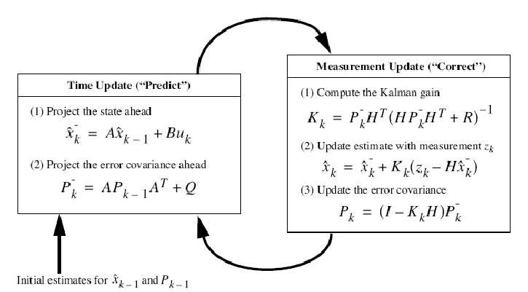
Filters
OBJECTIVE FUNCTION
INPUT DATA
ESTIMATION
ESTIMATOR
MODEL
https://www.researchgate.net/figure/Kalman-filter-equations-and-instruction_fig3_283645465
Notes:
And the basic construction of such a filter is shown on this slide.
First: Some Input e.g. Sensor measurement
Second: feeds the estimator, model is giving a prediction the next state based on the incoming data, Objective Function: specifies the goals that have to be achieved by the estimator
Model: something that can predict measurements: in the case of the gps: position = position_0 + velocity*time + 0.5*accel*time^2;
Example of an Estimator: Kalman Filter
Here you see on the left side the model and on the right sidey you see the objective function indicated by (1); 2 and 3 are giving then the output after a short update
(Next Slide)

Slide 6
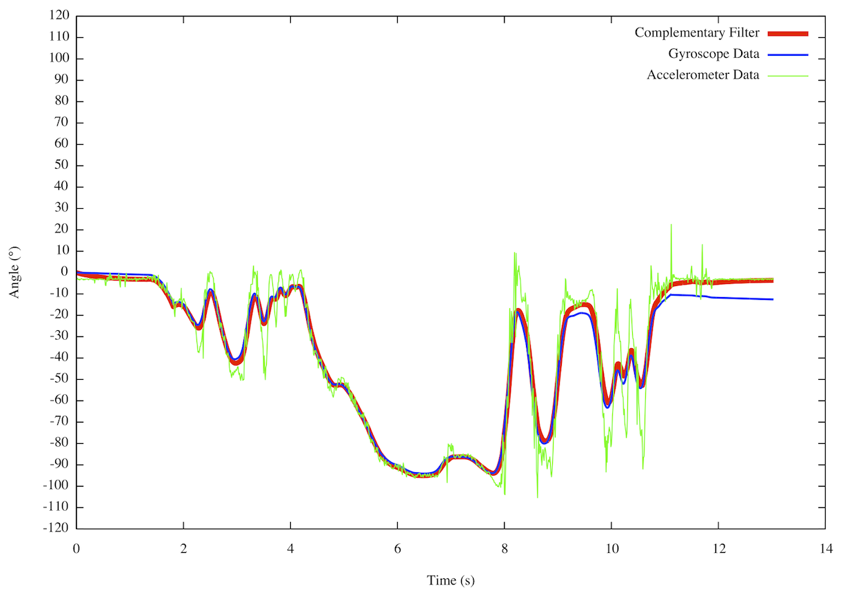
Accelerometer and Gyroscope
http://www.pieter-jan.com/images/Complementary_Filter.png
Notes:
Here you can see a implementation of a simple filter, a so called complementary filter. It is weighting the inputs of the accelerometer and the gyroscope, so setting a gain and afterwards their added together.

Slide 7
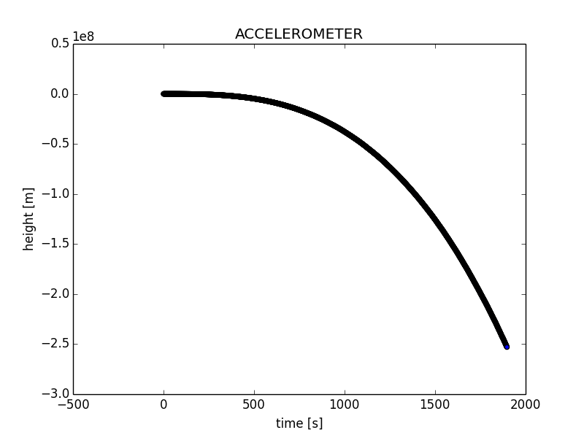
accelerometer
Made by Riccardo‘s computer
Notes:
Sometimes it is also a good idea to calibrate the sensor to prevent such things like this (hit Enter)
Accelerometer deosn‘t show zero when there is no acceleration;
Z axis also reads the gravitational force which must substract to get the real acceleration
That‘s one of the anoying difficulites I have

Slide 8
Evaluation of my ma
What was the most difficult?
Developing a reasonable sensor fusion algorithm, which is giving me the results I want
How did you overcome this difficulty?
By learning a lot of math, mainly statistics
AND by looking at datasheets of my sensors
What must be improvemed for my MA?
My product ☺
It could be the case that I have to exchange the whole hardware system by an alternative, due to certain error made by the microcontroller (e.g. storage of values)
Next steps:
Finding out the behaviour of the measurement noise, so that an appropriate filter can be chosen
Implementation of filter-system
Tests

Slide 9
Questions?

